Slide 1
Design Review 6
Team 513
Automated Flux Reader (AFR)

Slide 2
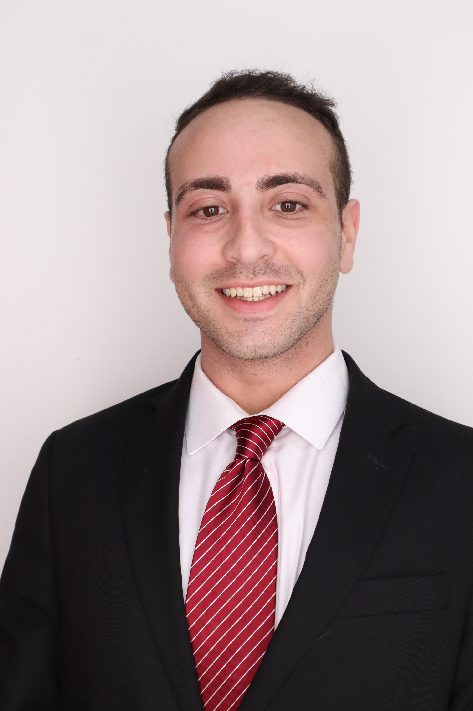
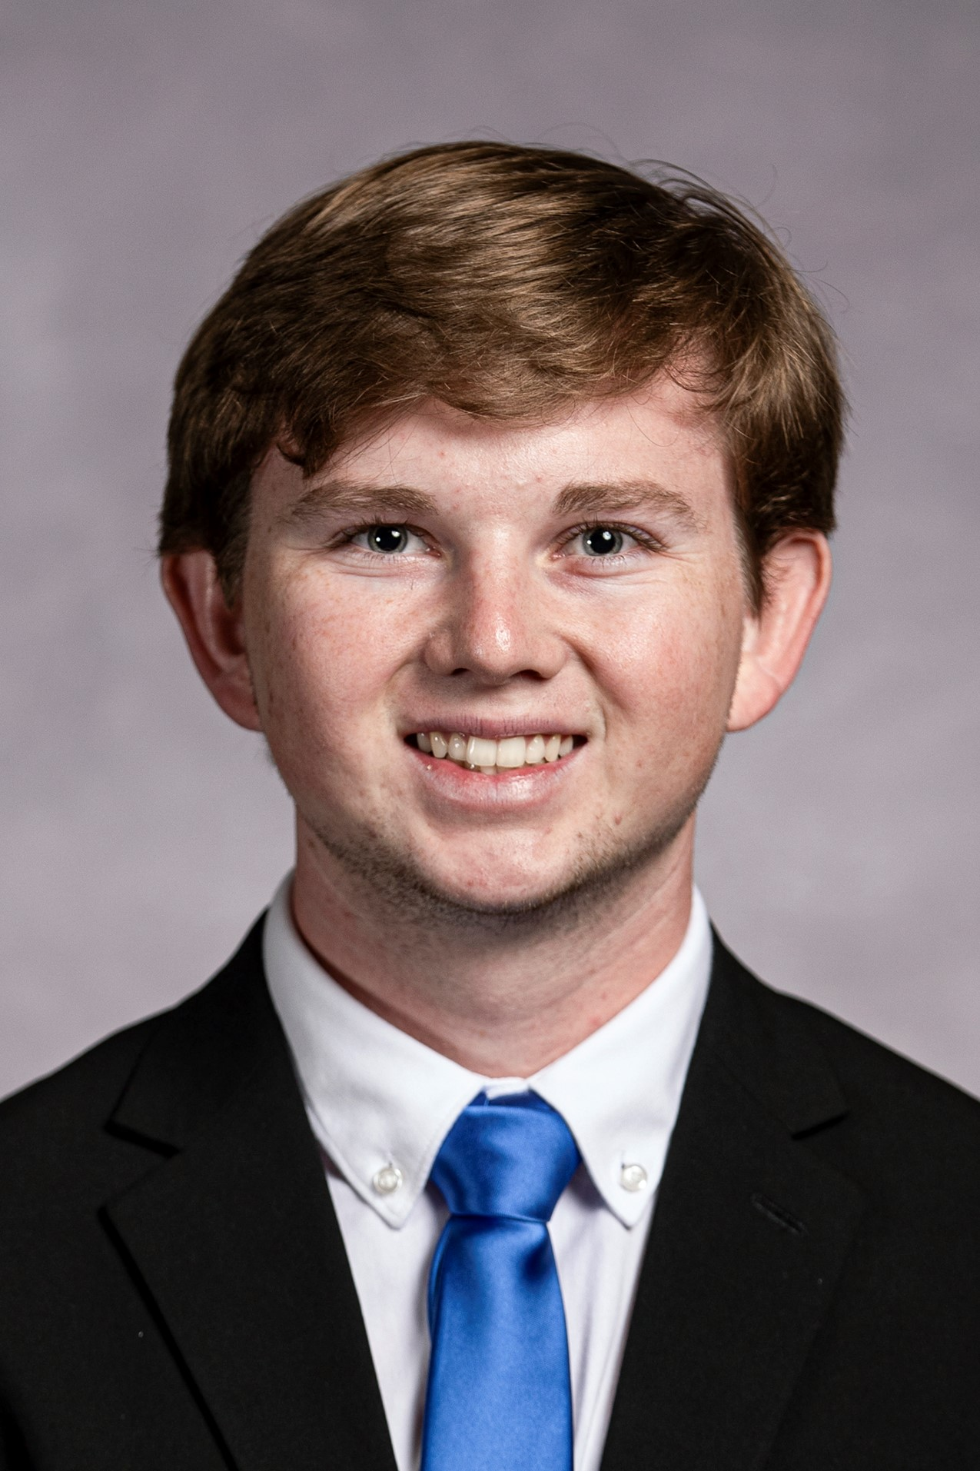
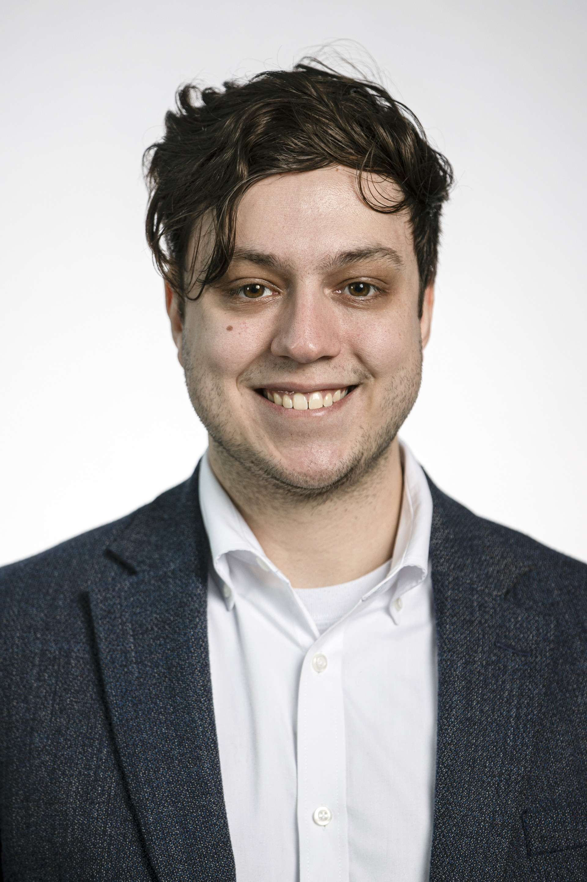
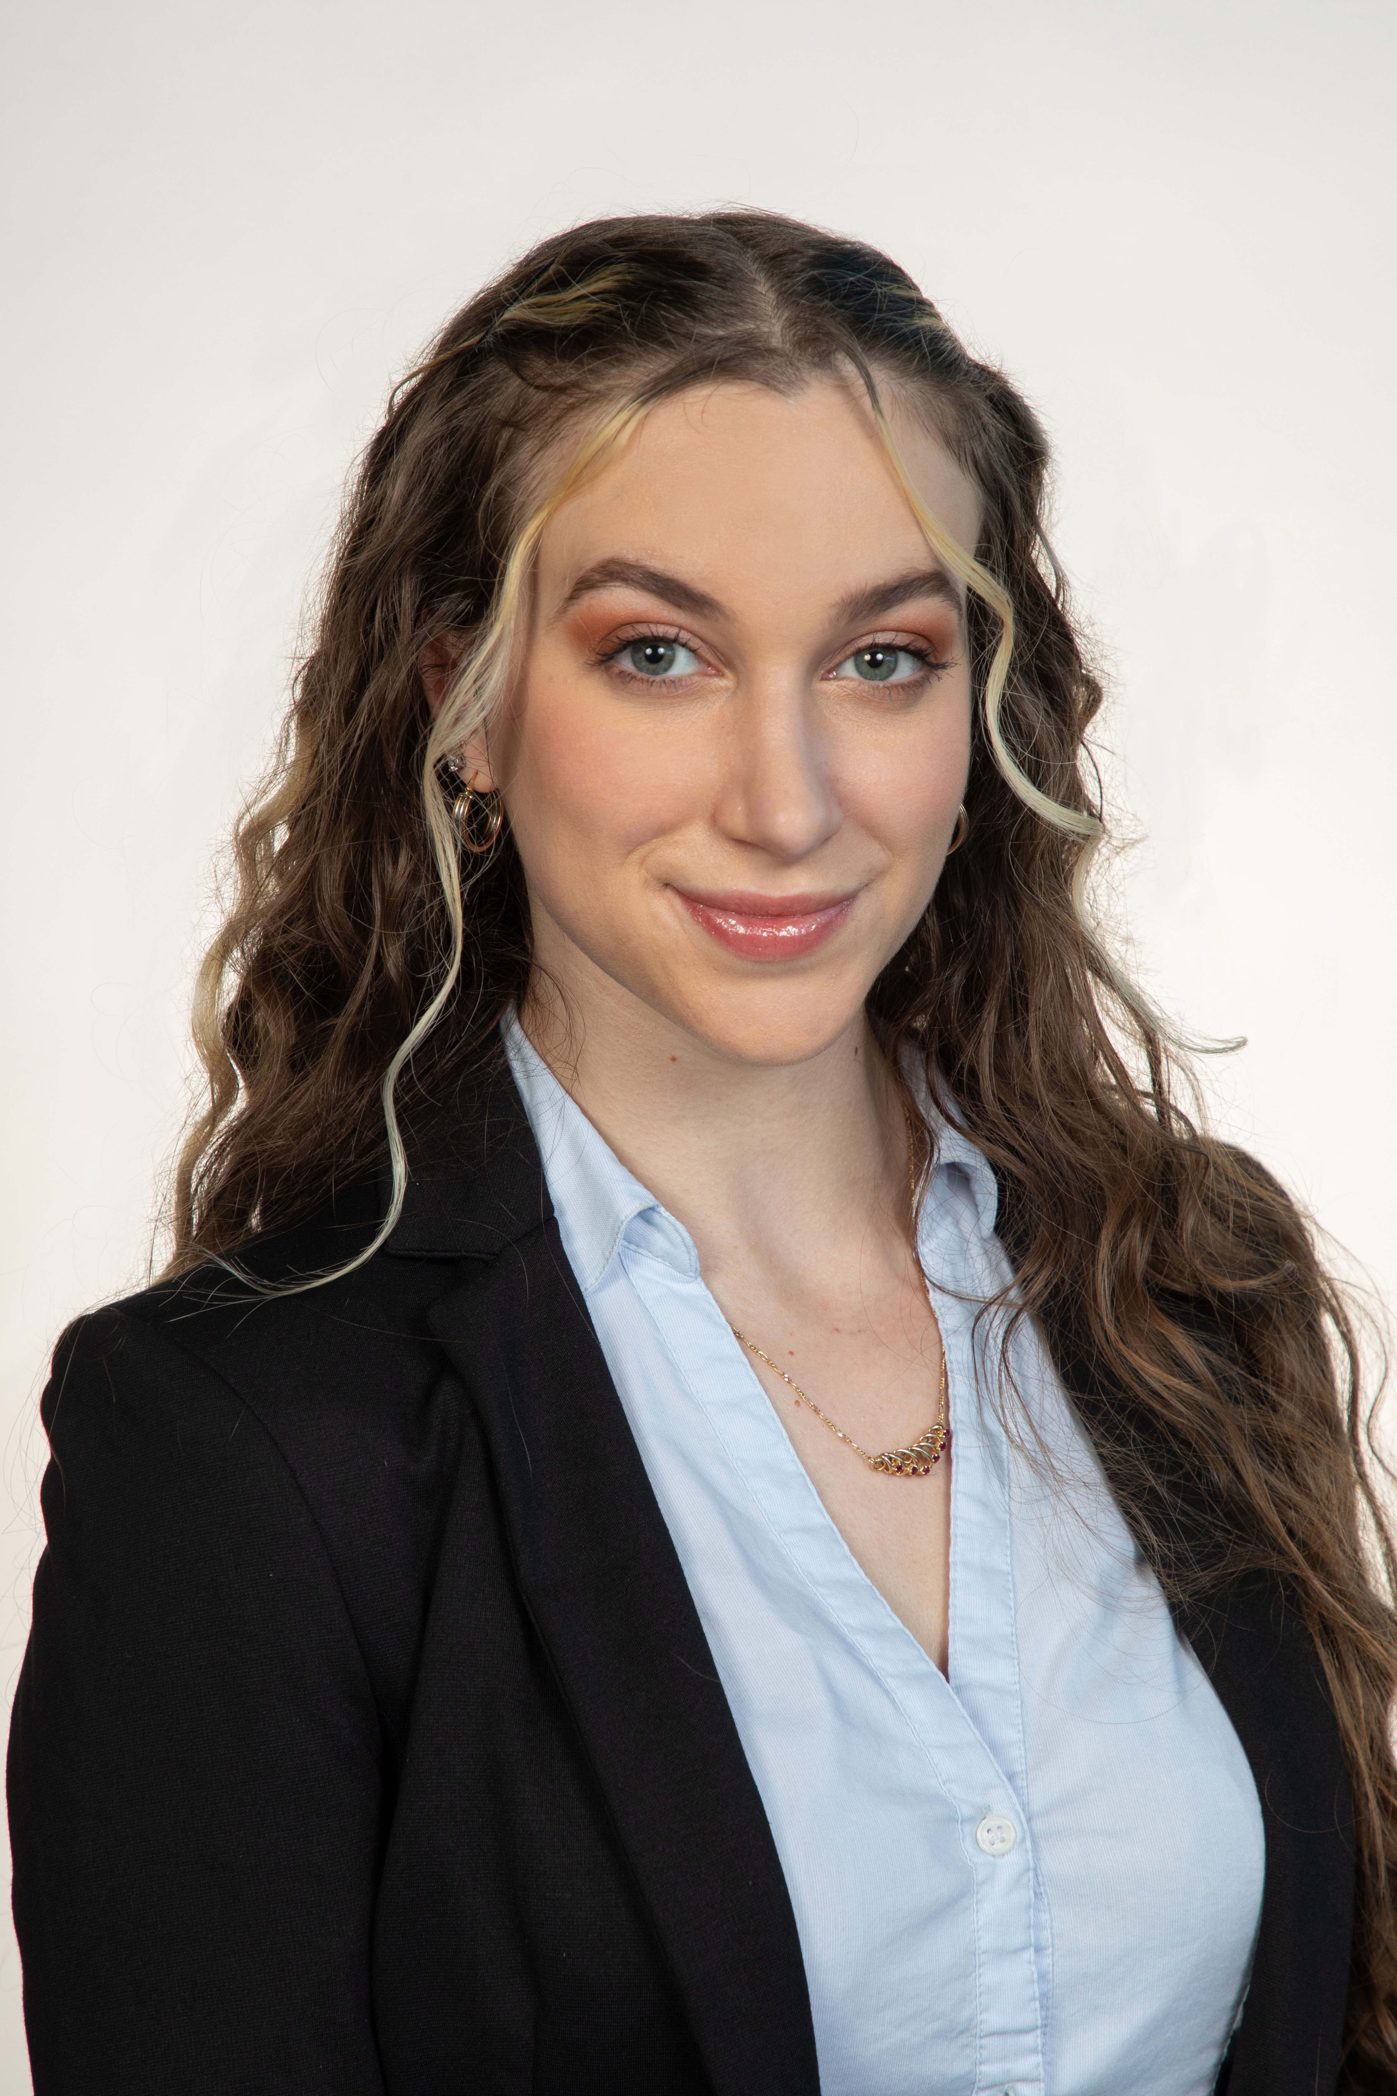
Team Introductions
Joshua Huls
Andrew Atallah
Hardware & Software
Engineer
Sean Hemstreet
Design Engineer
Joshua Huls
Systems Engineer
Liora Louis
Materials &
Test Engineer

Slide 3

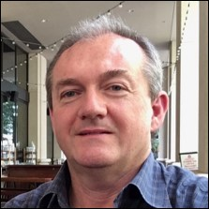
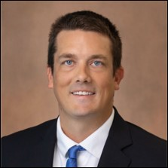
Sponsor and Advisor
Joshua Huls
Engineering Mentor
William Bilbow
Director of Technology & Project Manager
Engineering Mentor
Cole Gray
Mechanical Design Engineer

Slide 4
Objective
Joshua Huls
The objective of this project is to design a device that will be capable of fully measuring and recording the magnetic flux of compressor shafts in an automated way that allows for accurate measurements, repeatability, and less overall firsthand work for the operator.

Slide 5
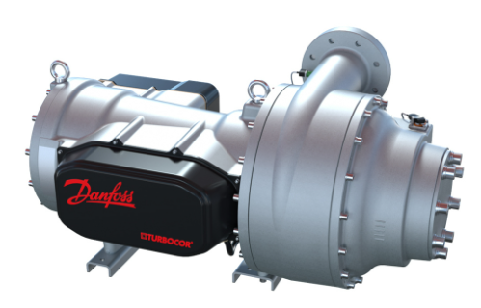
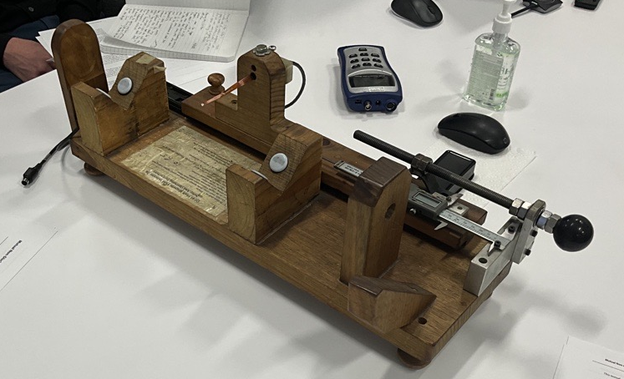
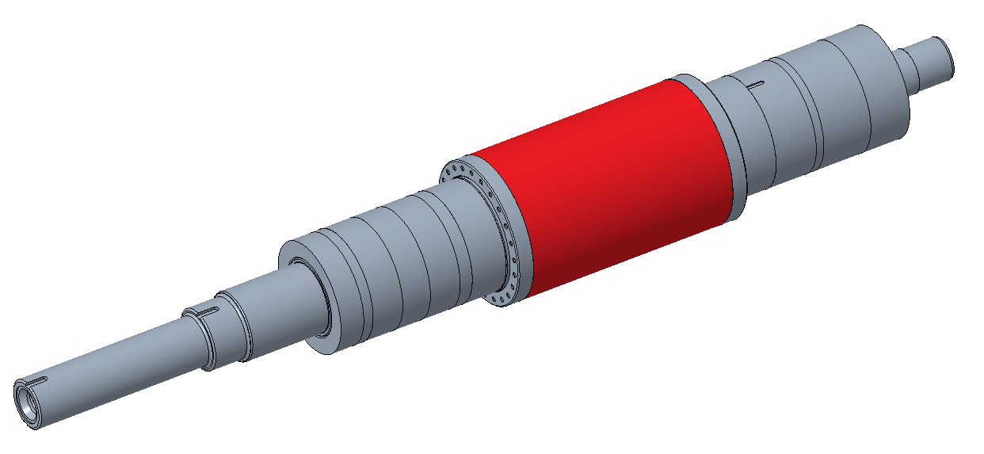
Background
Joshua Huls
Compressors deliver high efficiency and low sound levels
Oil-free magnetic bearing
The use of our project is for the use in new batches and new designs
Previous manual method was inconsistent work intensive

Slide 6




Key Goals
Joshua Huls
Automation
Consistency
Adaptability
Accuracy

Slide 7
Assumptions
Joshua Huls
Device is used over a period of 3 months per year.
Open-source software.
Given one working fluxmeter and sensor.
Testing will be performed at Danfoss.
Operator will be able to load shaft onto device.

Slide 8
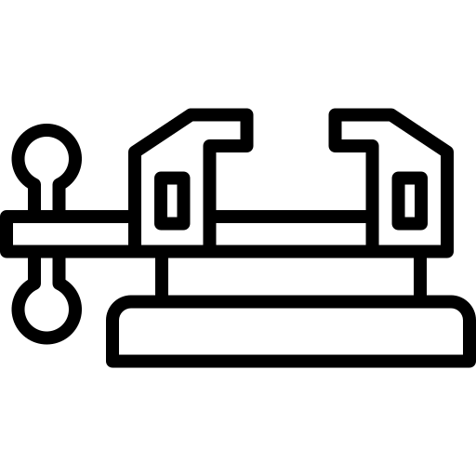





Targets and Metrics
Joshua Huls
Secures Sample
Data Transfer
Repeatability
Resolution (5mm)
Structural Durability

Slide 9

Concept Generation
Liora Louis
An in-depth process involving multiple team meetings in which team members produced design ideas together and discussed individuals' ideas as a team to compile a list of wildly varying designs.
Anti-Problem
Biomimicry
Crapshoot
Forced Analogy
Brainstorming

Slide 10
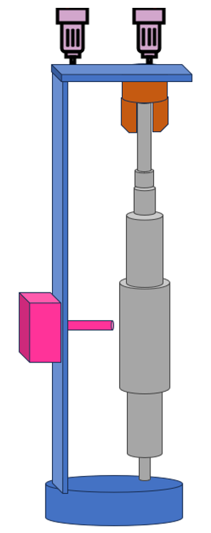
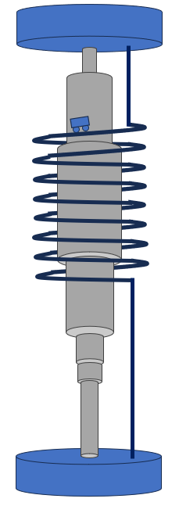
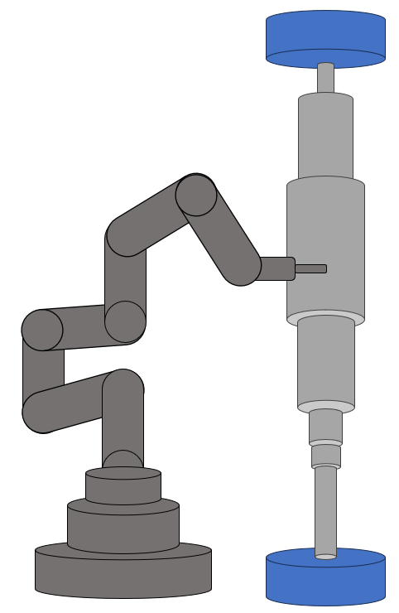
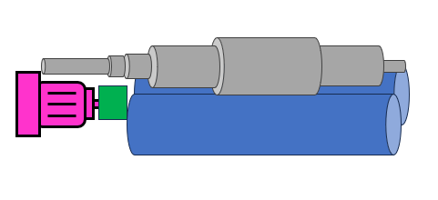
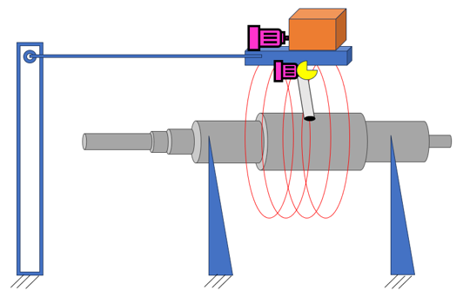
Medium Fidelity Concepts
Liora Louis
1
2
5
1
2
3
4
5
3
4
Vertical Lathe Device
Roller Conveyor Belt Device
Robotic Arm Device
Typewriter Rail System Device
Helical Cage Device

Slide 11
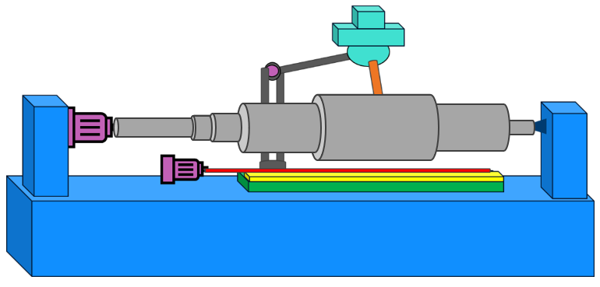
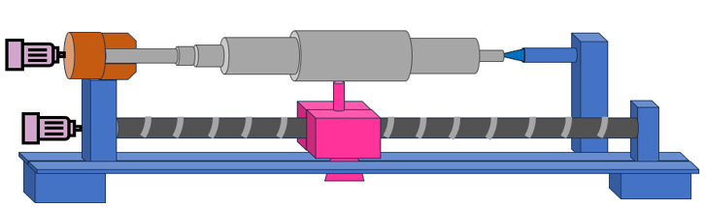
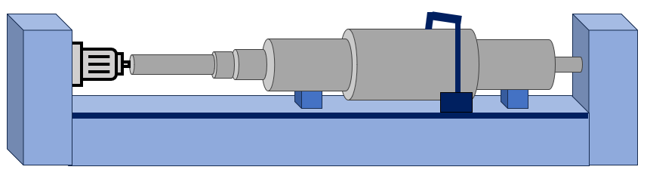
High Fidelity Concepts
Liora Louis
1
2
3
1
2
3
Horizontal Lathe Device
Horizontal Roller Bearings Device
Lean and Peck Sensor Probe Device

Slide 12
Concept Selection
Liora Louis
Binary Pairwise Comparison
House of Quality (HoQ)
Pugh Charts
Analytical Hierarchy Process (AHP)

Slide 13

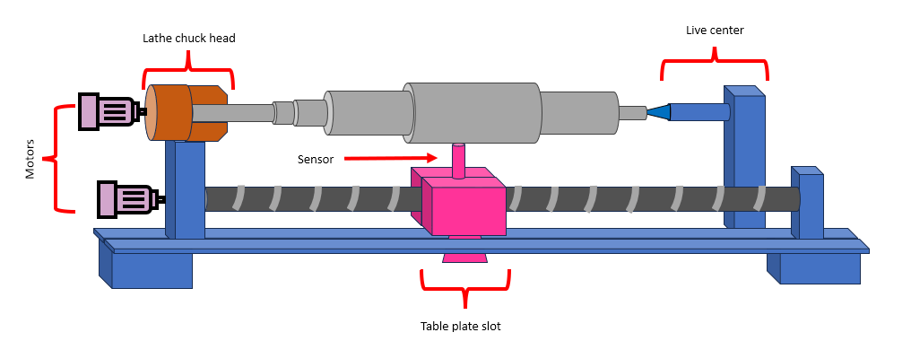


Selected Concept
Liora Louis
Reliable Measurement Feedback
Consistent Measurements
Measures Entire Region
Secures and Levels Sample
Horizontal Lathe
Adaptable

Slide 14
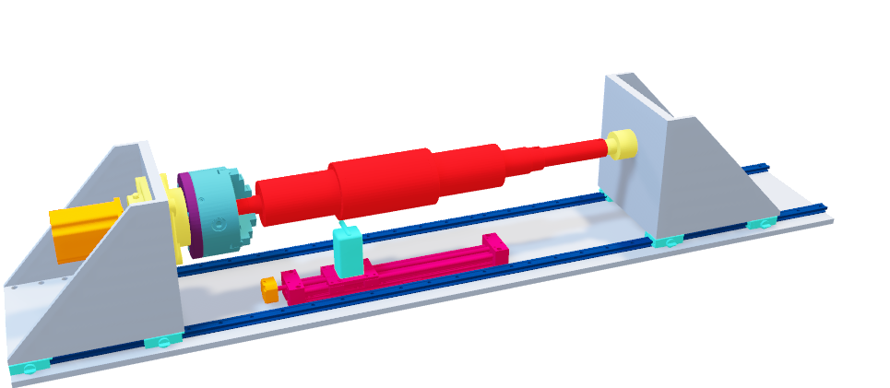
Initial Design
Liora Louis
Design Elements
Two Triangle Bracket Supports
1
Custom Chuck Head Assembly
2
Live Center
3
Tracks to Move the Brackets
4
Linear Guide Rail
5

Slide 15
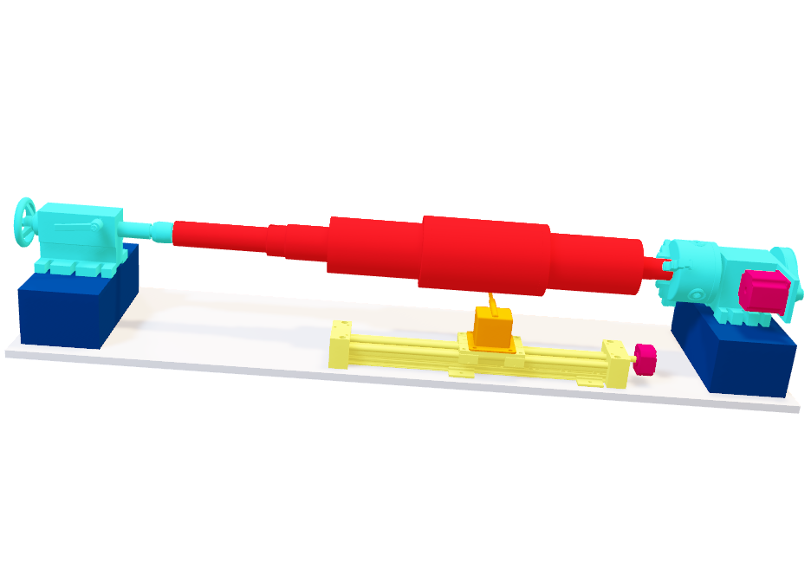
Second Design Iteration
Sean Hemstreet
Design Benefits
Added 3-inch aluminum blocks
1
2
3
3
4

Slide 16
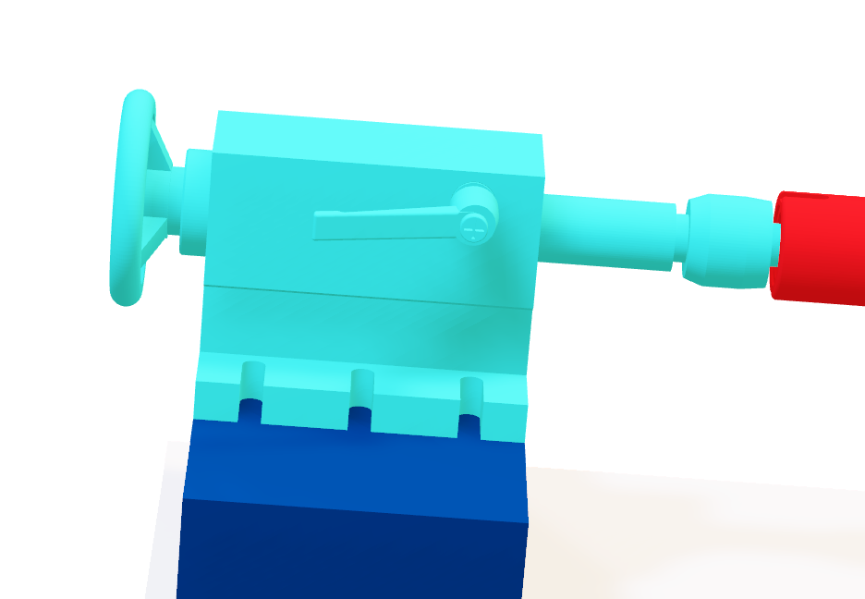
Second Design Iteration
Sean Hemstreet
Design Benefits
Added 3-inch aluminum blocks
1
Adjustable tailstock with wheel
2
3
3
4

Slide 17
Second Design Iteration
Sean Hemstreet
Design Benefits
Added 3-inch aluminum blocks
1
Adjustable tailstock with wheel
2
Singular lever lock for live center
3
3
4

Slide 18
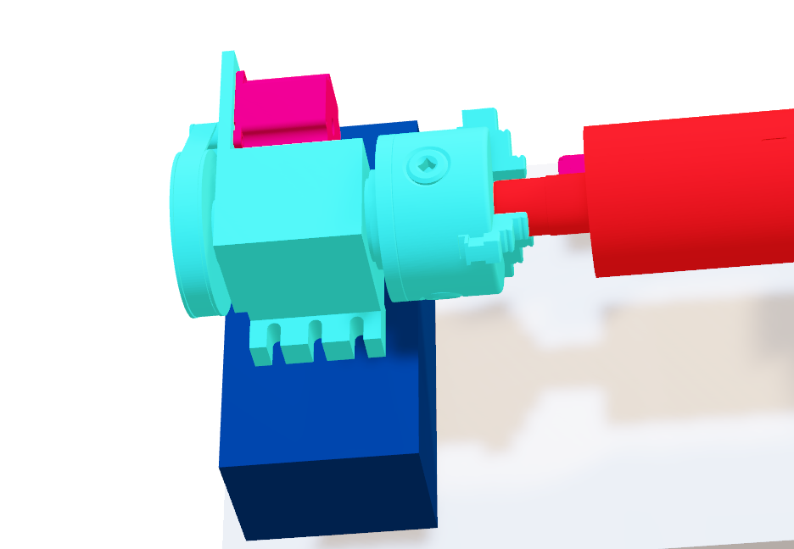
Second Design Iteration
Sean Hemstreet
Design Benefits
Added 3-inch aluminum blocks
1
Adjustable tailstock with wheel
2
Singular lever lock for live center
3
Preassembled chuck head
4

Slide 19
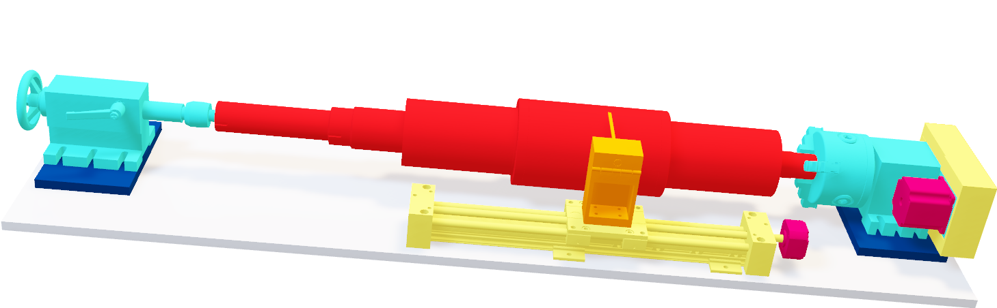
Final Design Iteration
Sean Hemstreet
Design Updates
1
2
3

Slide 20
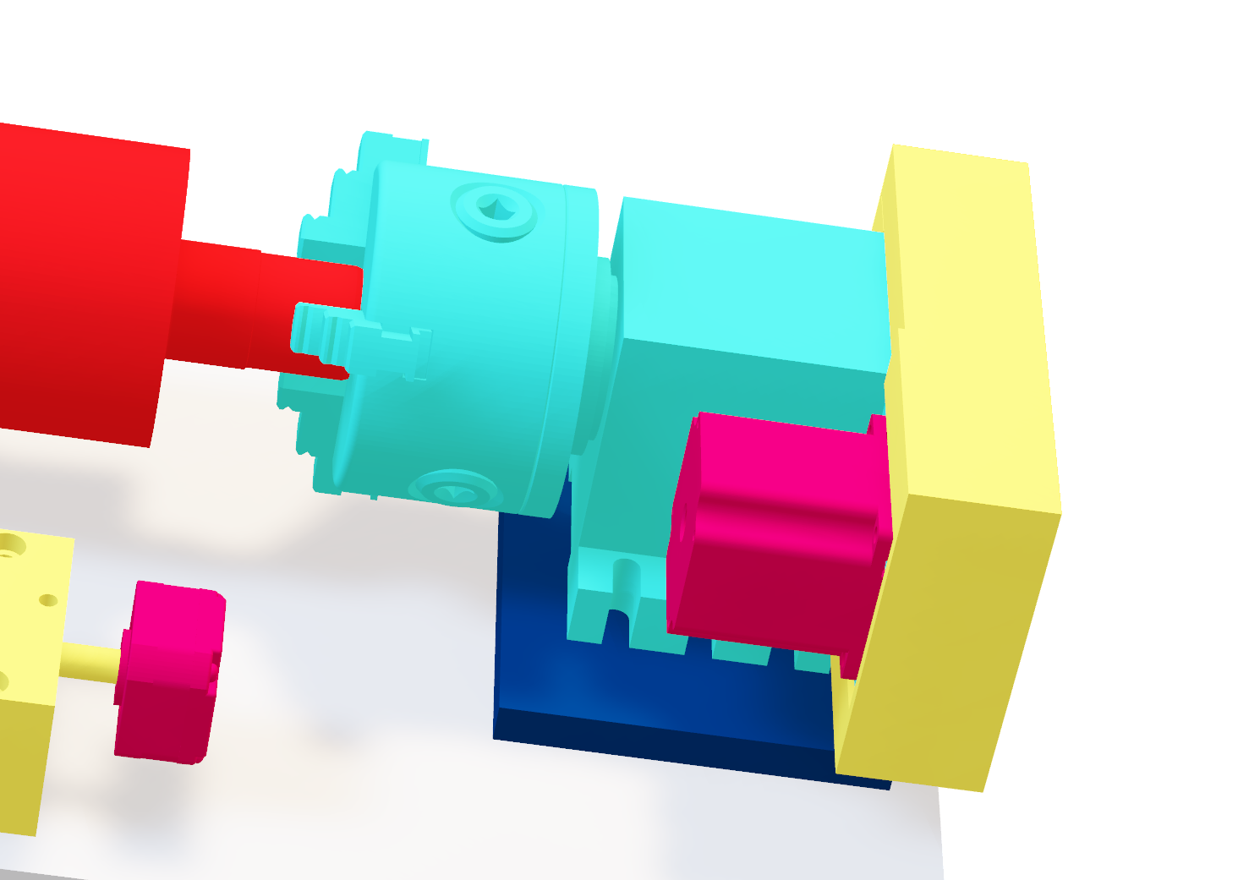
Final Design Iteration
Sean Hemstreet
Design Updates
Chuck head belt cover
1
2
3

Slide 21
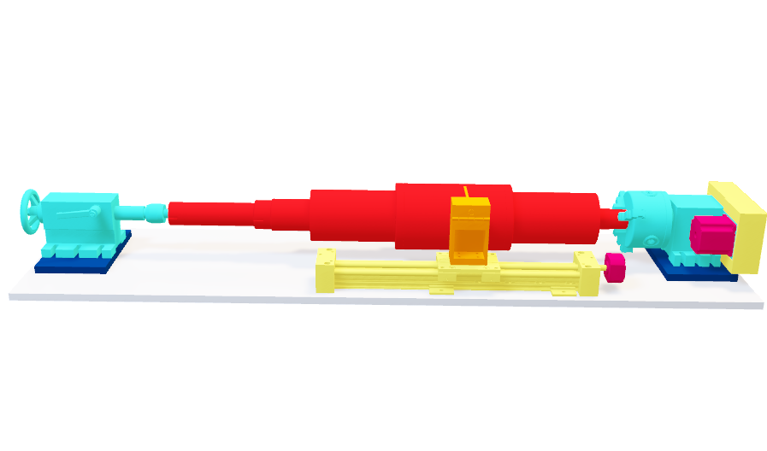
Final Design Iteration
Sean Hemstreet
Design Updates
Chuck head belt cover
1
Using 0.5-inch aluminum blocks
2
3

Slide 22
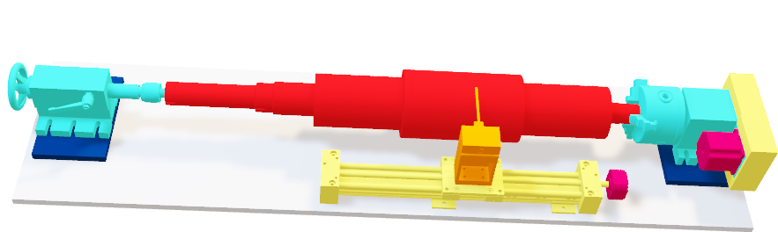
Final Design Iteration
Sean Hemstreet
Design Updates
Chuck head belt cover
1
Using 0.5-inch aluminum blocks
2
Measuring the top of the shaft
3

Slide 23
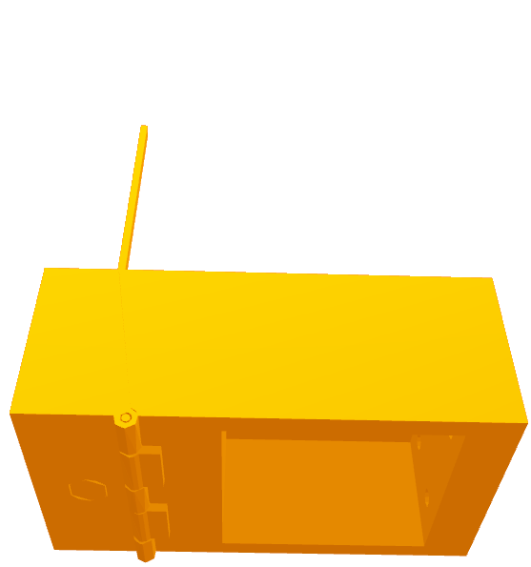
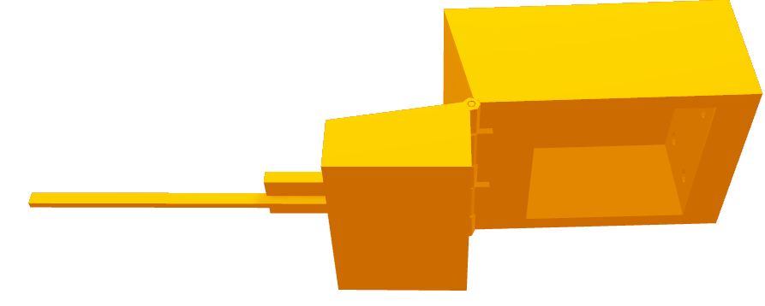
Fluxmeter Probe Housing
Joshua Huls
Hinge for moving probe out of way during specimen loading
Notes:
2 positions, open and closed to move the sensitive and delicate sensor probe out of the way when loading

Slide 24
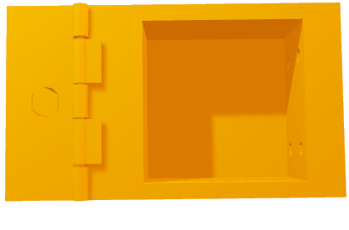
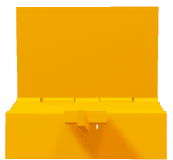
Fluxmeter Probe Housing
Joshua Huls
Tapered probe fitting
9.5 mm
8.3 mm
Notes:
Taper to ensure a secure fit for the probe

Slide 25
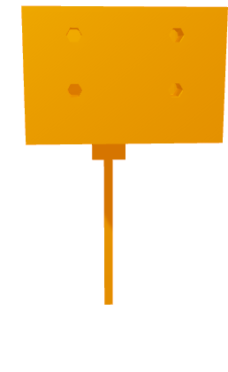
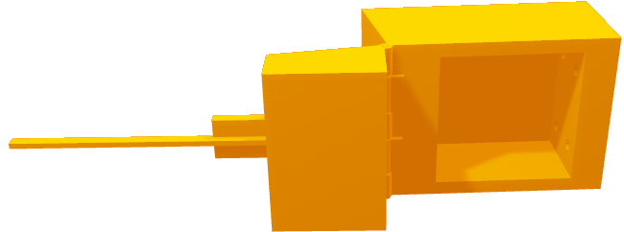
Fluxmeter Probe Housing
Joshua Huls
Cavity and holes for fastening housing to linear guide rail
Notes:
Not only are fasteners necessary to attach to the linear system as a hole, but a way to feasibly insert and remove the fasteners was needed

Slide 26


Fluxmeter Probe Housing
Joshua Huls
Probe rest to reinforce sensor probe angel
Notes:
As urged by my collogues a rest was implemented into the housing design to reinforce the probe’s angle of detection to better ensure an optimal tangential angle to the shaft and to support the probe if it loses stiffness over time as its predecessor did.

Slide 27






Operation
Andrew Atallah
Shaft is loaded via crane
Power supply, Arduino, and fluxmeter are plugged in
User selects the type of shaft being measured
Measurements and recordings begin
Shaft is aligned and secured
User opens the program

Slide 28
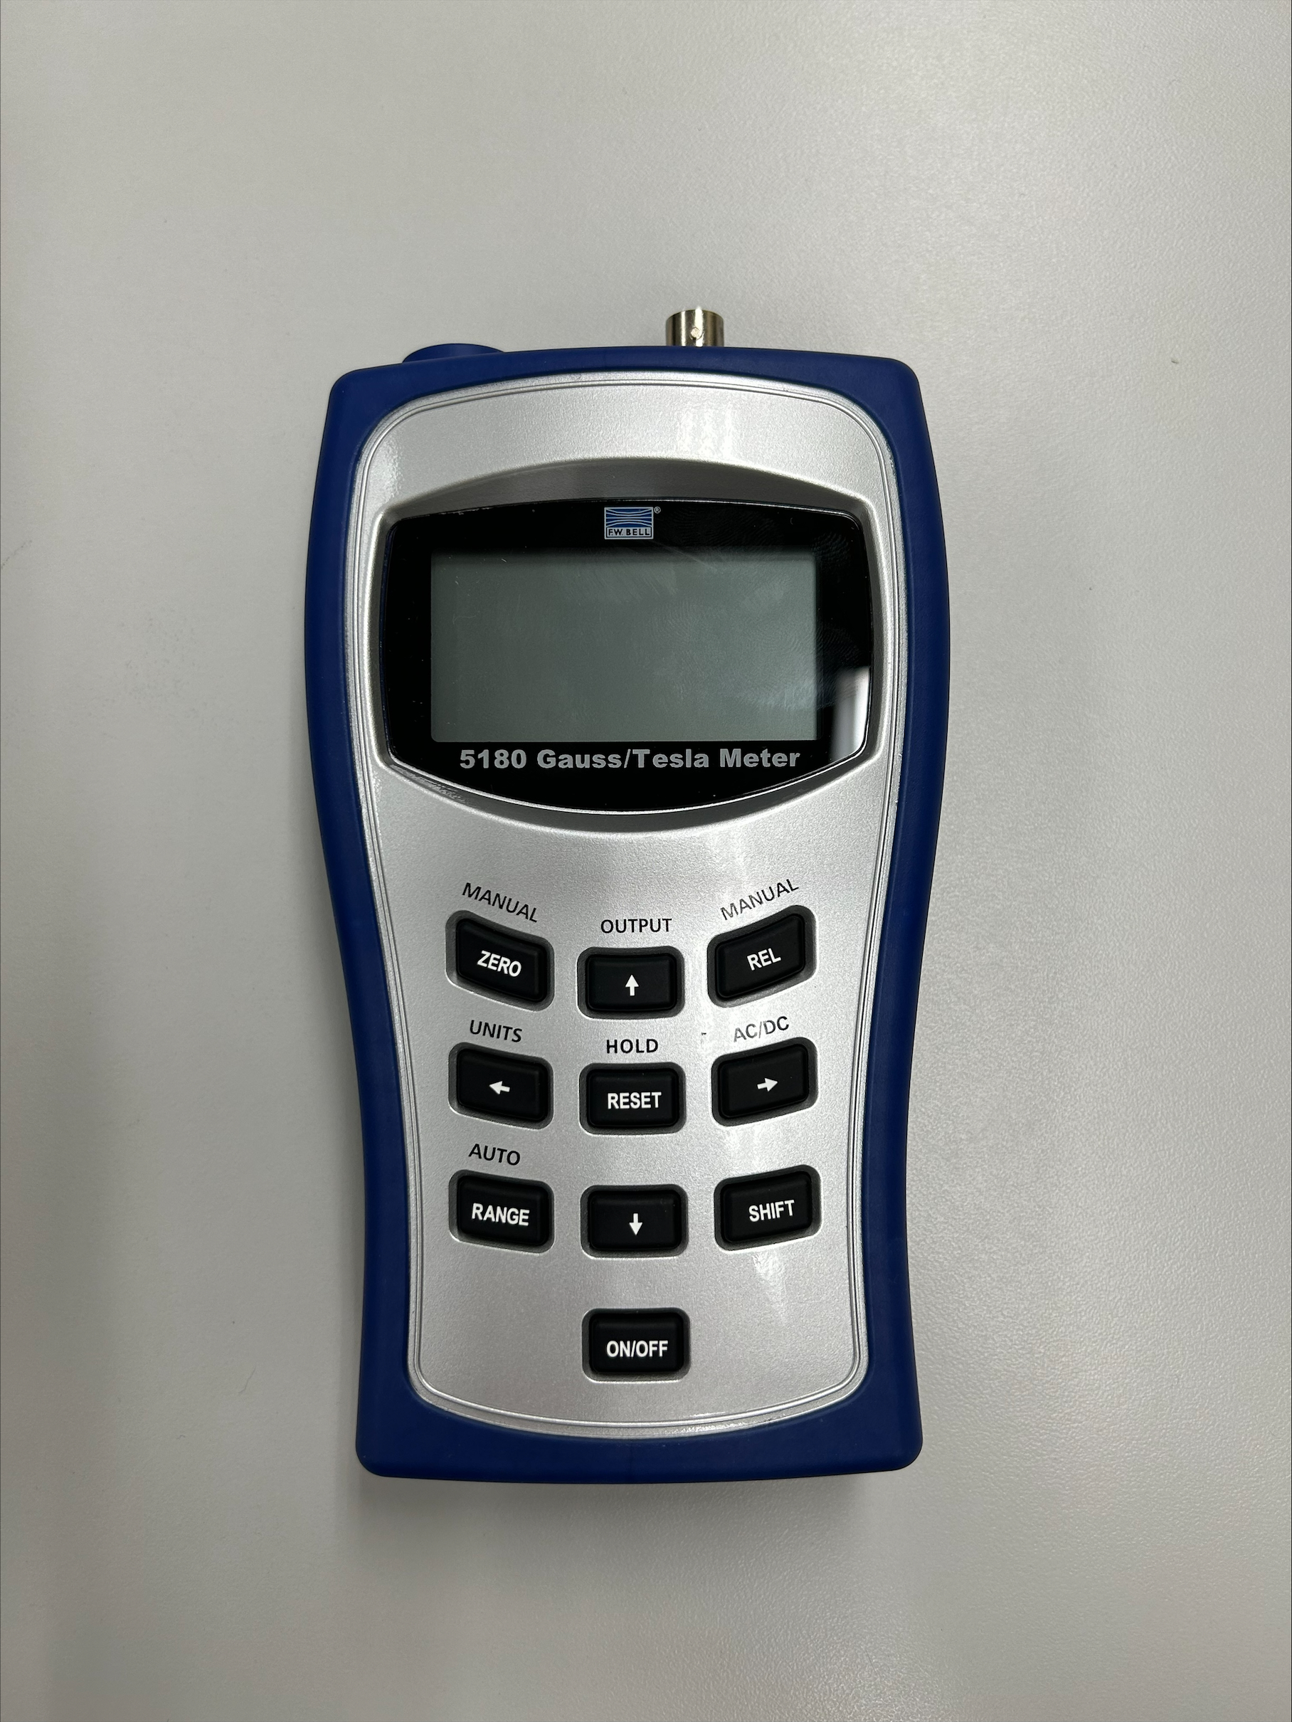
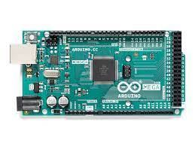

Mechatronic Design
Andrew Atallah
Limit Switch (LS)
Arduino
Fluxmeter
Start via C++ Application
Platform moves until LS is hit
Measurement is taken
Platform moves along the shaft,
with stops for measurement
taken every 5 mm
Shaft is rotated 5 mm
Steps 3-5 gets repeated until the
shaft completes a full rotation
Data gets sent to an Excel
Template
1
Motor Driver 1
Power Supply
Motor Driver 2
2
3
4
Stepper Motor 1
Stepper Motor 2
5
6
7

Slide 29
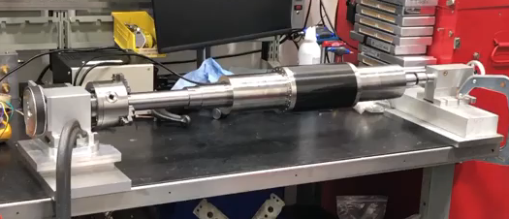
Testing and Validation
Andrew Atallah
Confirmed the chuck head was large enough
Confirmed the tailstock and live center were strong enough
Confirmed the NEMA 23 motor was more than capable

Slide 30
Work in Progress
Andrew Atallah
Finish assembly
Test finalized code on the 3D printed shafts
Test the resolution of device
Finish integrating mechatronics components
Refine operations by testing on the real shafts at Danfoss Turbocor

Slide 31




Improvements
Sean Hemstreet
Install a progress indicator onto device with LCD screen
Implement an auto-leveling sensor for device
Versatile code that can measure future shafts that Danfoss designs
Flux probe mount with adjustable height

Slide 32




Budget Breakdown
Sean Hemstreet
Remaining Budget
Structural Components
$9,600
$2,400
$1,700
$700
Money Spent
Electronics

Slide 33




Lessons Learned
Sean Hemstreet
Planning ahead is important
Be prepared for setbacks
Ensure parts ordered fit
Challenges are often seen as simple tasks

Slide 34
Summary
Joshua Huls
Automated, Accurate, Consistent, Adaptable
Generate and Select Concept
Turn Concept Into Design
Build and Test
Notes:
Formulate key objectives and goals
Consider the problems presented and form possible concepts for solutions to choose from as a team
Determine what is needed to turn the device idea into a reality, find and design parts, systems and operations to accomplish all key goals and handle all foreseen problems
Assemble gathered resources into the final product and verify that is works as expected, while adapting to new and unforeseen problems and circumstances. This stage is where prior planning and group communication with one another and our sponsor have benefited us the most as we have been able to pivot when necessary to ensure at no point the projects brought to a complete stop. And that advancements are being even in between things like order arrivals and use of machining equipment.

Slide 35
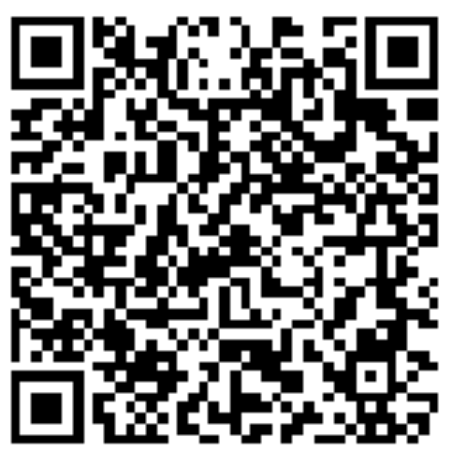
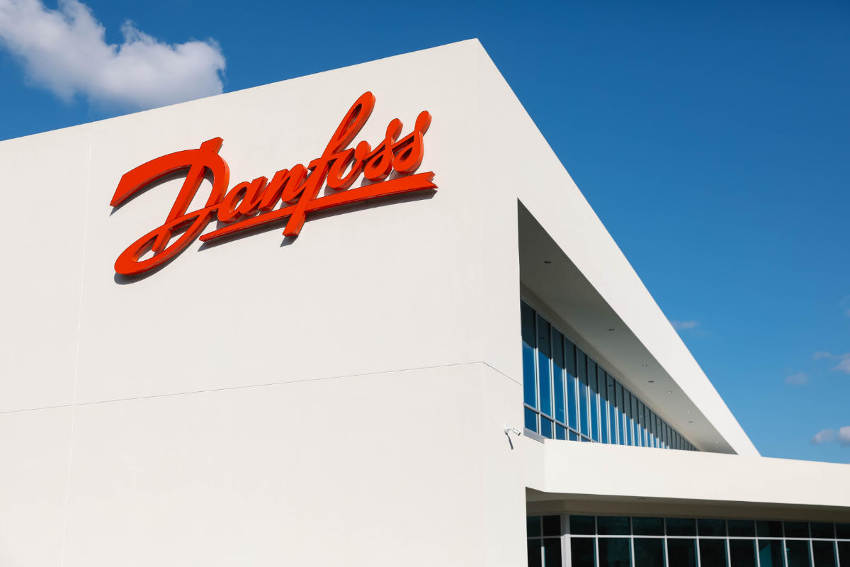



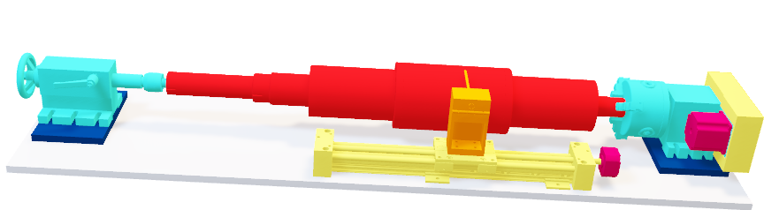
Automated Flux Reader
Joshua Huls
Andrew Atallah
aatallah@fsu.edu
Sean Hemstreet
sph19@fsu.edu
Joshua Huls
jth18b@fsu.edu
Liora Louis
llouis@fsu.edu

Slide 36
This is 10-point
This is 15–point Times
This is 20–point
This is 25–point
This is 30–point
This is 35–point
This is 40–point
This is 50–point
This is 60–point
This is 72–point
Notes:
Use at least 20-point font in Room A105, B134, and B136
Use at least 25-point font in Room B135

Slide 37
College of Engineering Color Palette
1 2 3 4
Pantone: PMS 195 C
RGB: 120, 47, 64
Hex: #782F40
CMYK:19, 90, 50, 55
1 2 3 4
Pantone: Black C
RGB: 0, 0, 0
Hex: #000000
CMYK:0, 0, 0, 100
Garnet
Black
1 2 3 4
RGB: 238, 118, 36
Hex: #EE7624
CMYK:2, 66, 99, 0
1 2 3 4
Pantone: PMS 000C
RGB: 255, 255, 255
Hex: #FFFFFF
CMYK: 0, 0, 0, 0
Fang
Orange
White
Notes:
Avoid 75% Black in B135

Slide 38
Accent Color Palette
1 2 3 4
RGB: 0, 59, 111
Hex: #003B6F
CMYK:
1 2 3 4
RGB: 0, 59, 111
Hex: #003B6F
CMYK:
1 2 3 4
RGB: 251, 236, 93
Hex: #FBEC5D
CMYK:
1 2 3 4
RGB: 219, 215, 210
Hex: #DBD7D2
CMYK:
1 2 3 4
RGB: 251, 236, 93
Hex: #FBEC5D
CMYK:
1 2 3 4
RGB: 219, 215, 210
Hex: #DBD7D2
CMYK:
Tardis Blue
Tardis Blue
Corn
Timberwolf
Corn
Timberwolf
1 2 3 4
RGB: 206, 0, 88
Hex: #CE0058
CMYK: 0, 100, 43, 12
1 2 3 4
RGB: 206, 0, 88
Hex: #CE0058
CMYK: 0, 100, 43, 12
1 2 3 4
RGB: 104, 40, 96
Hex: #682860
CMYK:
1 2 3 4
RGB: 220, 220, 220
Hex: #DCDCDC
CMYK:
Rubine Red
Rubine Red
Imperial
Gainsboro
1 2 3 4
RGB: 72, 146, 155
Hex: #48929b
CMYK:
1 2 3 4
RGB: 64, 224, 208
Hex: #40E0D0
CMYK:
1 2 3 4
RGB: 255, 139, 0
Hex: #FF8B00
CMYK:
Asagi-iro
Turquoise
American Orange
Notes:
Remove American orange add hyperlink grey
Make corn the last for b135
All work in 134 imperial move later
Tardis doesn’t work in b136

Slide 39
F7AB19
D67F15
EE7624
D64615
F73119
Analogous
https://color.adobe.com/create/color-wheel
6E3610
F0A16C
EE7624
6E4931
BASB1C
Monochromatic
A14508
4BED3B
EE7624
250CED
2010A1
Triad
A1470C
FF8C40
EE7624
0098A1
24E2ED
Complementary
28A164
2FED8D
EE7624
0848A1
1871ED
Split Complementary
EDAC2F
3BED93
EE7624
0C6AED
ED2F18
Double Split Complementary
ED660C
C7ED3B
EE7624
0CE1ED
A418ED
Square
BA7E09
87724A
EE7624
60EFCF
09BA61
Compound
AD551A
6E3610
EE7624
FA7625
D46820
Shades
Notes:
These are the variants that work well with Fang Orange. The bolded items show well on the projectors.

Slide 40
85412D
8F3831
782f40
8F3176
792D85
Analogous
https://color.adobe.com/create/color-wheel
C44D69
8E626D
782F40
C48796
451B25
Monochromatic
C43959
78743B
782F40
236178
43A2C4
Triad
C43959
C46078
782F40
25C43D
2F783A
Complementary
93C460
577835
782F40
39C49D
297861
Split Complementary
784435
5A783B
782F40
237860
6E2978
Double Split Complementary
782337
78683b
782F40
237830
293978
Square
AB4D32
DEBAAF
782F40
5D8555
70AB32
Compound
38161E
C44D69
782F40
853447
5E2532
Shades

Slide 41
A105
A105
B135 Stage Left
B135 Stage Right
B136
B134, A105
B135

